Slide 1
Bias, Variance, and K-Nearest Neighbors
CSC4601 Theory of Machine Learning

Slide 2
Overview
Last week, we discussed linear vs non-linear models, and we motivated graphically what we mean by complex vs simple models.
Each model has its own advantages and disadvantages, and each model makes certain assumptions.
Which model to choose? Where to start?

Slide 3
No-Free-Lunch theorem
The “No Free Lunch” Theorem argues that, without having prior knowledge, there is no single model that will always do better than any other model.
Hence it is important to evaluate different approaches or techniques and select the best performing approach.
In this lecture, we will discuss:
Best practices on model evaluation
Overfitting vs Underfitting
Evaluation metrics (classification)

Slide 4
Model Evaluation

Slide 5
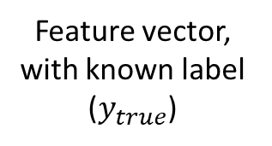



Model Evaluation
$$x=\left[\begin{aligned}x_{1} \\ \begin{aligned}x_{2} \\ \begin{aligned}⋮ \\ x_{m}\end{aligned}\end{aligned}\end{aligned}\right]$$
Learned Model
$$f(.)$$
Predicted Label (Output)
Feature vector, with known label ($y_{true}$)
$$y_{pred}=f(x)$$
To evaluate the performance of a machine learning model on a dataset (consisting of feature vectors and known labels), we need quantify how close the model’s predictions are to the true labels of the given dataset.

Slide 6
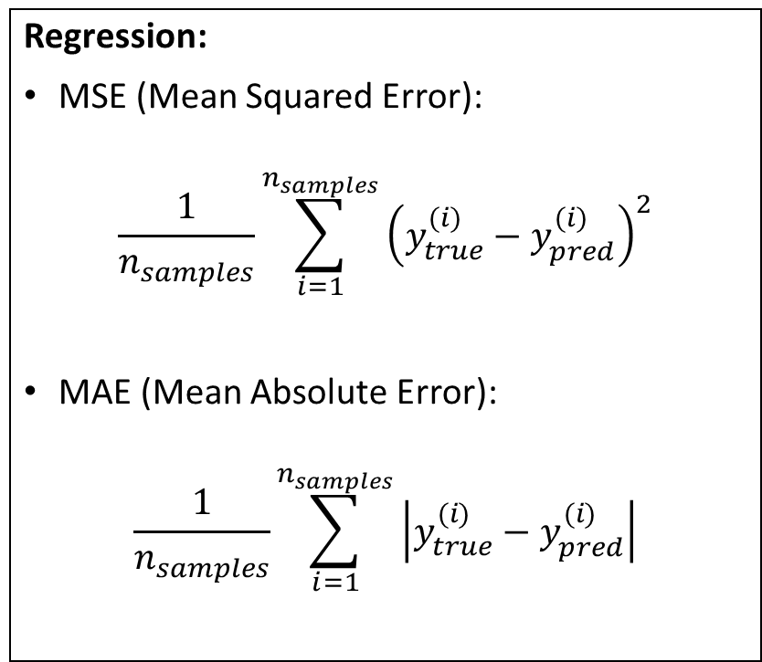
Evaluation Metrics (you may have used)
Regression:
MSE (Mean Squared Error):
$$\frac{1}{n_{samples}}\sum_{i=1}^{n_{samples}}{{\left(y_{true}^{(i)}−y_{pred}^{(i)}\right)}^{2}}$$
MAE (Mean Absolute Error):
$$\frac{1}{n_{samples}}\sum_{i=1}^{n_{samples}}{\left|y_{true}^{(i)}−y_{pred}^{(i)}\right|}$$
Classification:
Accuracy: proportion of correctly predicted labels
Other metrics?

Slide 7
Model Evaluation
When do we need to evaluate a model?
And on which data set?

Slide 8
Model Evaluation – Final Model
Data Pre-processing
Feature Engineering
Feature Scaling
Data Splitting into training and testing sets
Training
Use the training set to perform:
Model Fitting
Model selection: cross-validation, model tuning
Evaluation
Evaluation of final model on testing set
Prediction
Use the final model to predict the labels for new unlabeled data
Data needs to be split into training and testing sets:
the training set should be used in the training phase to select the most promising model;
the testing set should be used in the evaluation phase to evaluate the final model.
No observations are present in both sets.

Slide 9
Train-Test Data Splitting
Why can’t we evaluate the final model on the training set?

Slide 10
Train-Test Data Splitting
Evaluating the final model on the training set may result in an optimistic performance: the final model might have picked up on some patterns that only exist in the training data.
We’re interested in evaluating the performance of the model on unseen data: estimating the generalization error. How well will the model generalize to unseen data?
Our experimental setup needs to match (simulate) how we intend to use the model.

Slide 11
Model Evaluation – Is train-test splitting enough?
Data Pre-processing
Feature Engineering
Feature Scaling
Data Splitting into training and testing sets
Training
Use the training set to perform:
Model Fitting
Model selection: cross-validation, model tuning
Evaluation
Evaluation of final model on testing set
Prediction
Use the final model to predict the labels for new unlabeled data
During the training phase, we might need to try different approaches: train different models, fine-tune some of them (Model Selection).
To select the best model, can we rely on the performance of each model on the entire training set?

Slide 12
Validation Set
Training set needs to be further split into sub-training and validation sets:
Initial Dataset
Training Set
Testing Set
Sub-training Set
Validation Set
Testing Set
The different models are trained using the sub-training set and then evaluated on the validation set.
The final model with the best performance on the validation set is the one that is chosen and finally evaluated on the test set.

Slide 13
Validation Set
If the size of the data is very large, partitioning the training set into sub-training and validation sets once is enough.
Otherwise, the performance of any model might be sensitive to how we partition the data into sub-training and validation sets.
Solution: K-fold cross-validation

Slide 14
Validation Set – K-fold cross-validation
Validation fold
Initial Dataset
Training fold
Training Set
Testing Set
Divide the training set into 5 folds
1
2
3
4
5
Train the model 5 times. In each time, use one fold as the validation set and the remaining folds as the sub-training set.
Average performance on all validation folds

Slide 15
Underfitting, Overfitting

Slide 16
Model Evaluation
Splitting the data into training and testing sets and performing cross-validation on the training test help us:
not choose an overfit or underfit model.
What is overfitting and underfitting?

Slide 17
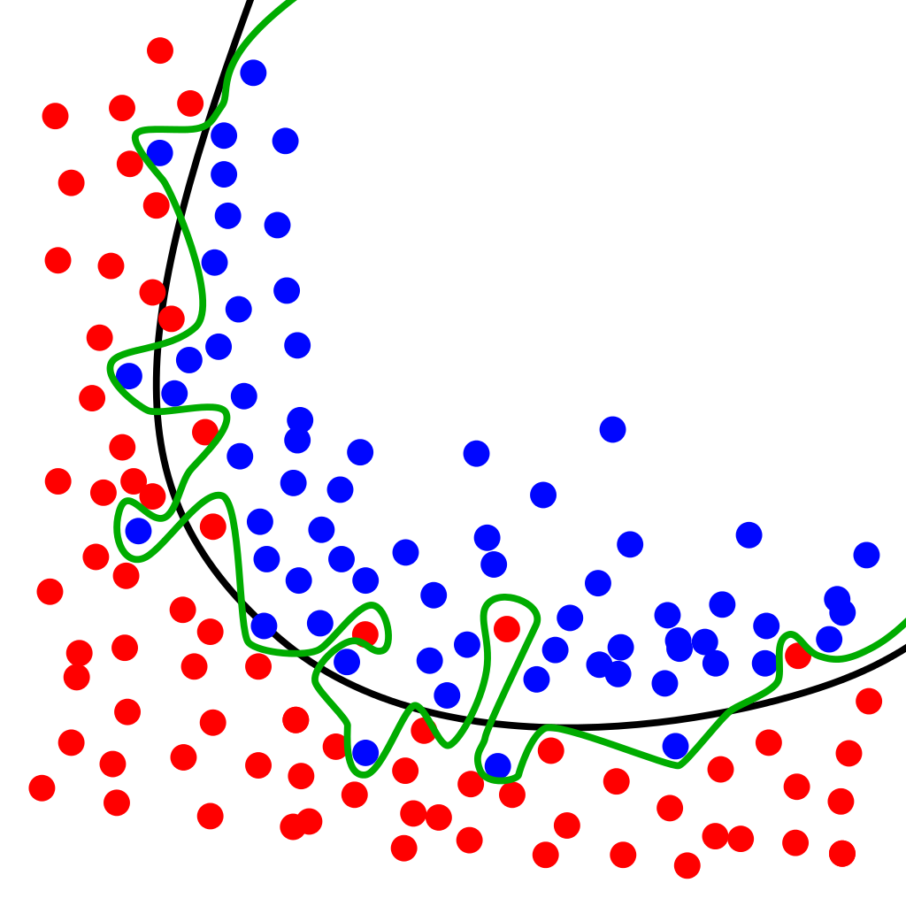
Possible Scenarios

Slide 18
Possible Scenarios
A model, can be bad for two different reasons:
Model that poorly fits the data, is too simple and doesn’t match the data well: it is said to have high bias (underfit model).
Model that overly fits the data, is too complex and too specific for the data: is said to have high variance (overfit model).
The Goldilocks model!

Slide 19
Possible Scenarios
A model’s error can be expressed as the sum of three different errors:
Bias
Variance
Irreducible error: Irreducible error refers to the noise that exists in the data itself. It is an aspect of the data, and we cannot beat it.

Slide 20
Bias
Bias:
Bias refers to the error that is introduced due to wrong assumptions such as approximating a complicated pattern in data with a simpler model.
A high-bias or underfit model is a model that fails to capture the complex patterns in the training data.
An example is when we use a linear classification model on data that is not linearly separable.
In this case, both the training error and the validation/test error will be high.

Slide 21
Variance
Variance:
Variance captures how much a model is over-specialized to a particular training dataset.
Variance measures the consistency or variability of the model predictions if we retrain the model on a different training set, i.e., how much the model’s predictions change if it is trained on a different training set.
A high-variance or overfit model is a model that performs well on the training set by memorizing its specific patterns but fails to generalize to unseen data (validation/testing errors).
In this case, both the training error and the validation/test error will be high.

Slide 22
How do we know if a given trained model is underfit or overfit?
When a model does not perform well on the training set, we know that the model underfits the training set. Both the training error and the validation error of an underfit model will be high.
When a model performs very well on the training set, but fails to show similar performance on the validation set, we conclude that the model overfits the training set.

Slide 23
Bias-Variance Tradeoff
Error
Validation Error
Training Error
Model Complexity

Slide 24
Bias-Variance Tradeoff
High Bias (Underfitting)
High Variance (Overfitting)
Error
Validation Error
Training Error
Validation Error
Training Error
Model Complexity

Slide 25
What is KNN? Who is KNN? Where is KNN?

Slide 26
K-Nearest Neighbors (KNN)
Overview
KNN Training and Prediction Phase
What does affect KNN’s predictive power?
Choice of k, Feature Scaling
Advantages and Disadvantages

Slide 27
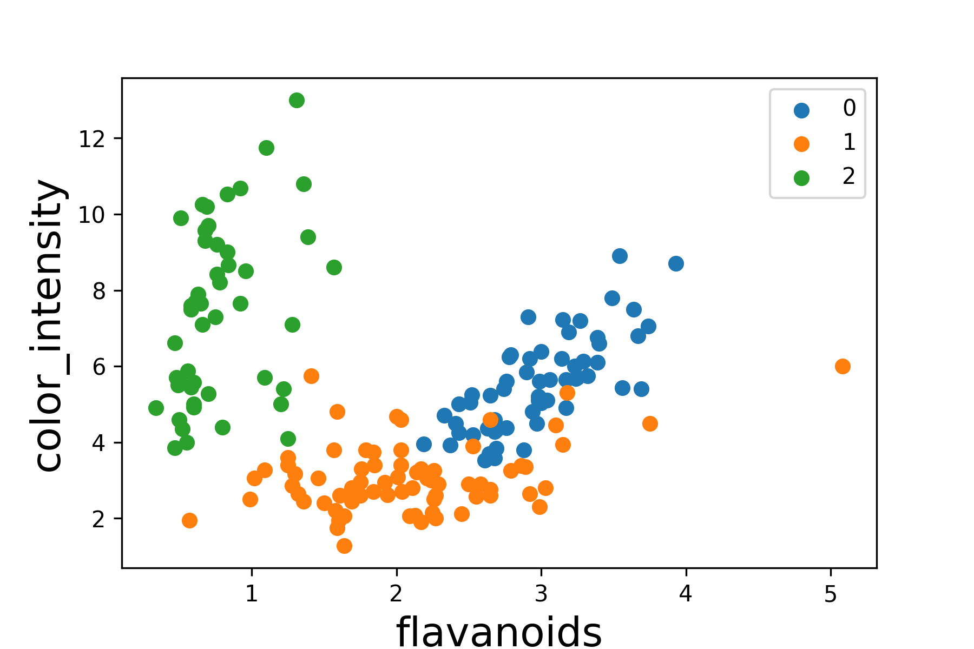
KNN
What label would you choose for the new data?

Slide 28
KNN
What label would you choose for the new data?
Key KNN – Assumptions:
Data samples that are close together (in some appropriate distance metric) are similar and will therefore have the same label.

Slide 29
KNN
Fundamental assumptions of KNN: Points similar to each other in feature space are likely belong to the same class
It uses a distance metric to reflect similarity between the data points
Distances are calculated between points to find the nearest neighbors

Slide 30
KNN
KNN is a simple machine learning algorithm for classification and regression.
The algorithm was first proposed in 1951 by Fix and Hodger. Then in 1967, Thomas cover provided further analytical results for the algorithm.
KNN has been suggested for a variety of applications: recommendation systems, missing data imputation, other applications.

Slide 31


KNN Overview
$x_{2}$
Class 3
?
Class 2
Class 1
$x_{1}$

Slide 32


KNN Overview
$x_{2}$
Class 3
$x_{2}$
Class 3
The 5 data samples that are closest to :
3 belong to class 2 (blue)
1 belongs to class 3 (green)
1 belongs to class 1 (orange)
Then the unlabeled data is predicted to belong to class 2 (blue).
?
Class 1
Class 2
Class 1
Class 2
$x_{1}$
$x_{1}$

Slide 33
Training Phase

Slide 34
Training Phase of KNN
KNN assumes no specific functional form for the relationship between a feature vector and its label.
There is no training phase: KNN is an example of lazy learner.
The algorithm just needs to store the training data. This memory-based learning is also known as instance-based learning which consists of comparing new data instances with instances seen in training.

Slide 35
What are the parameters of KNN?
The training data set itself is treated as the building blocks or the parameters for the KNN algorithm.
KNN is an example of non-parametric model:
a parametric model (like linear model) summarizes the training data with a finite set of parameters (irrespective of the number of samples in the training data).
KNN is non-parametric: it cannot be characterized by a finite set of parameters.

Slide 36
Prediction phase of KNN

Slide 37
Terminology
Reference points: training set data
Query point: new data point we want to classify
Neighbors: points near each other in some space

Slide 38
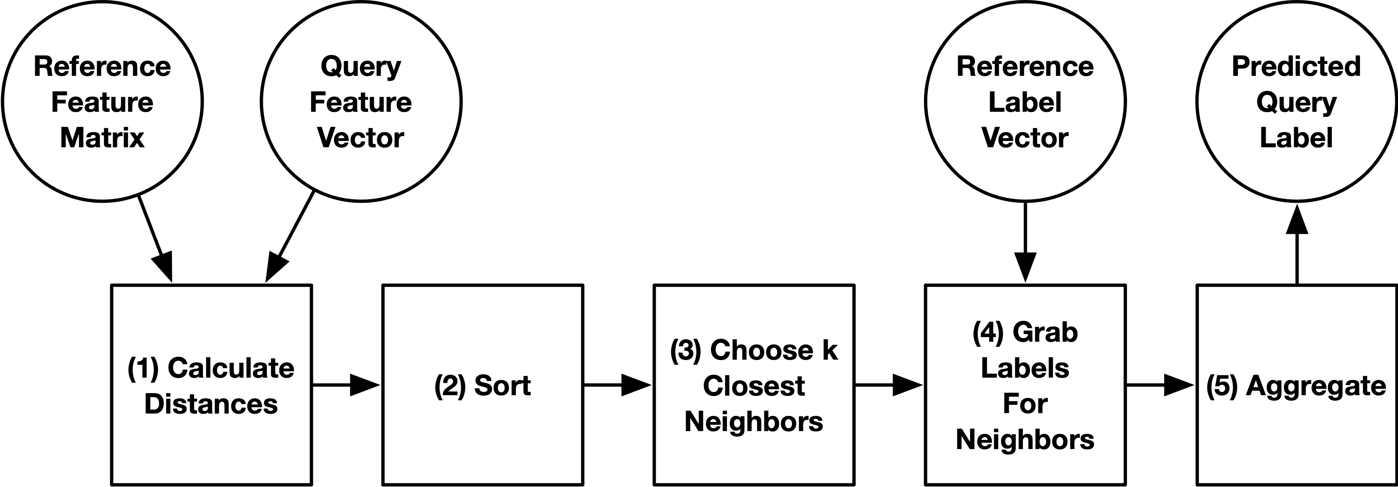
KNN Algorithm Flowchart
Training data (data with answers)
New data point without label

Slide 39
Step 1: Calculate Distances
We calculate the distance between the query point (star) and every reference point
Note that we do this in feature space!
Meaning, we calculate the distances between each pair of points using their feature vectors

Slide 40
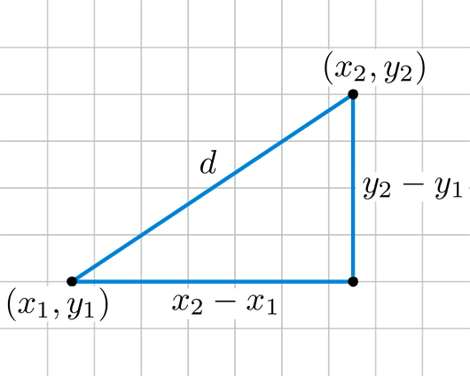

Step 1: Calculate Distances
The Euclidean distance of points represented as the vectors u and v can be calculated by: $$d=\left\|u −v\right\|$$
u = (u1, u2)
v = (v1, v2)
http://rosalind.info/glossary/euclidean-distance/

Slide 41
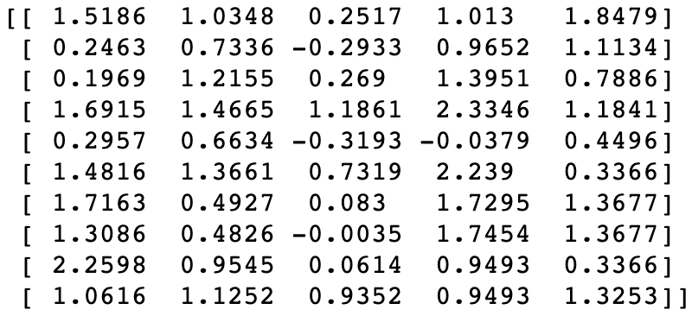
Step 1: Calculate Distances

Slide 42
Step 1: Calculate Distances
Index of reference data point in the training set | Distance to the query point
0 | 2.2404
1 | 1.2062
2 | 1.6820
3 | 3.3208
4 | 0.0001
We create a table of the index of every reference point (row in the feature matrix) and its distance to the query point

Slide 43
Step 2: Sort by Distance
Index of reference data point in the training set | Distance to the query point
0 | 2.2404
1 | 1.2062
2 | 1.6820
3 | 3.3208
4 | 0.0001
Sort the reference points by their distance from the query point

Slide 44
Step 2: Sort by Distance
Index of reference data point in the training set | Distance to the query point
4 | 0.0001
1 | 1.2062
2 | 1.6820
0 | 2.2404
3 | 3.3208
Sort the reference points by their distance from the query point

Slide 45
Step 3: Find the k-closest neighbors
Index of reference data point in the training set | Distance to the query point
4 | 0.0001
1 | 1.2062
2 | 1.6820
0 | 2.2404
3 | 3.3208
The k closest neighbors are kept

Slide 46
Step 3: Find the k-closest neighbors
Index of reference data point in the training set | Distance to the query point
4 | 0.0001
1 | 1.2062
2 | 1.6820
The k closest neighbors are kept

Slide 47
Step 3: Find the k-closest neighbors
Index of reference data point in the training set | Distance
4
1
2
We no longer use the distances
We can just drop them

Slide 48
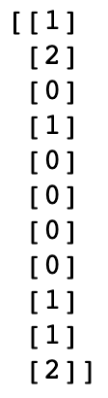
Step 4: Grab Labels for Neighbors
Index of reference data point in the training set | Labels
4
1
2

Slide 49
Step 4: Grab Labels for Neighbors
Index | Labels
4
1
2
Label vector for the reference points. Stores the class for each point as an integer. Indices match rows of feature matrix.

Slide 50
Step 4: Grab Labels for Neighbors
Index | Labels
4
1
2
Use the indices to get labels for reference points from label vector

Slide 51
Step 4: Grab Labels for Neighbors
Index | Labels
4 | 0
1 | 2
2 | 0
Use the indices to get labels for reference points from label vector

Slide 52
Step 5: Aggregate the Output Values
Index | Labels
4 | 0
1 | 2
2 | 0
Predicted Value
Classification:
Mode – most common value (majority vote)
Regression:
Mean
Median

Slide 53
Step 5: Aggregate the Output Values
Index | Labels
4 | 0
1 | 2
2 | 0
Predicted Value
Classification:
Mode – most common value
Regression:
Mean
Median

Slide 54
Step 5: Aggregate the Output Values
Index | Labels
4 | 0
1 | 2
2 | 0
Predicted Value | 0
Classification:
Mode – most common value
Regression:
Mean
Median

Slide 55
Run time and Space Complexity

Slide 56
Run Time Complexity
Assume there are n reference points, 1 query point, and m features that you will use the k closest neighbors
Step 1: Compute distances:
Step 2: Sorting the neighbor list (using a heap):
Step 3: Get known labels:
Step 4: Aggregation:

Slide 57
Run Time Complexity
Assume there are n reference points, 1 query point, and m features that you will use the k closest neighbors:
Step 1: Compute distances: O(nm)
Step 2: Sorting the neighbor list (using a heap): O(n log k) (if using max-heap)
Step 3: Get known labels: O(k)
Step 4: Aggregation: O(k)
Total run time: O(nm + n log k + k) = O(nm)

Slide 58
Space Complexity
Assume there are n reference points, 1 query point, and m features that you will use the k closest neighbors
The "training" step of KNN merely involves storing the n x m feature matrix and n-length label for the reference points.
Space complexity: O(nm + n) = O(nm)

Slide 59
How do we choose k?

Slide 60
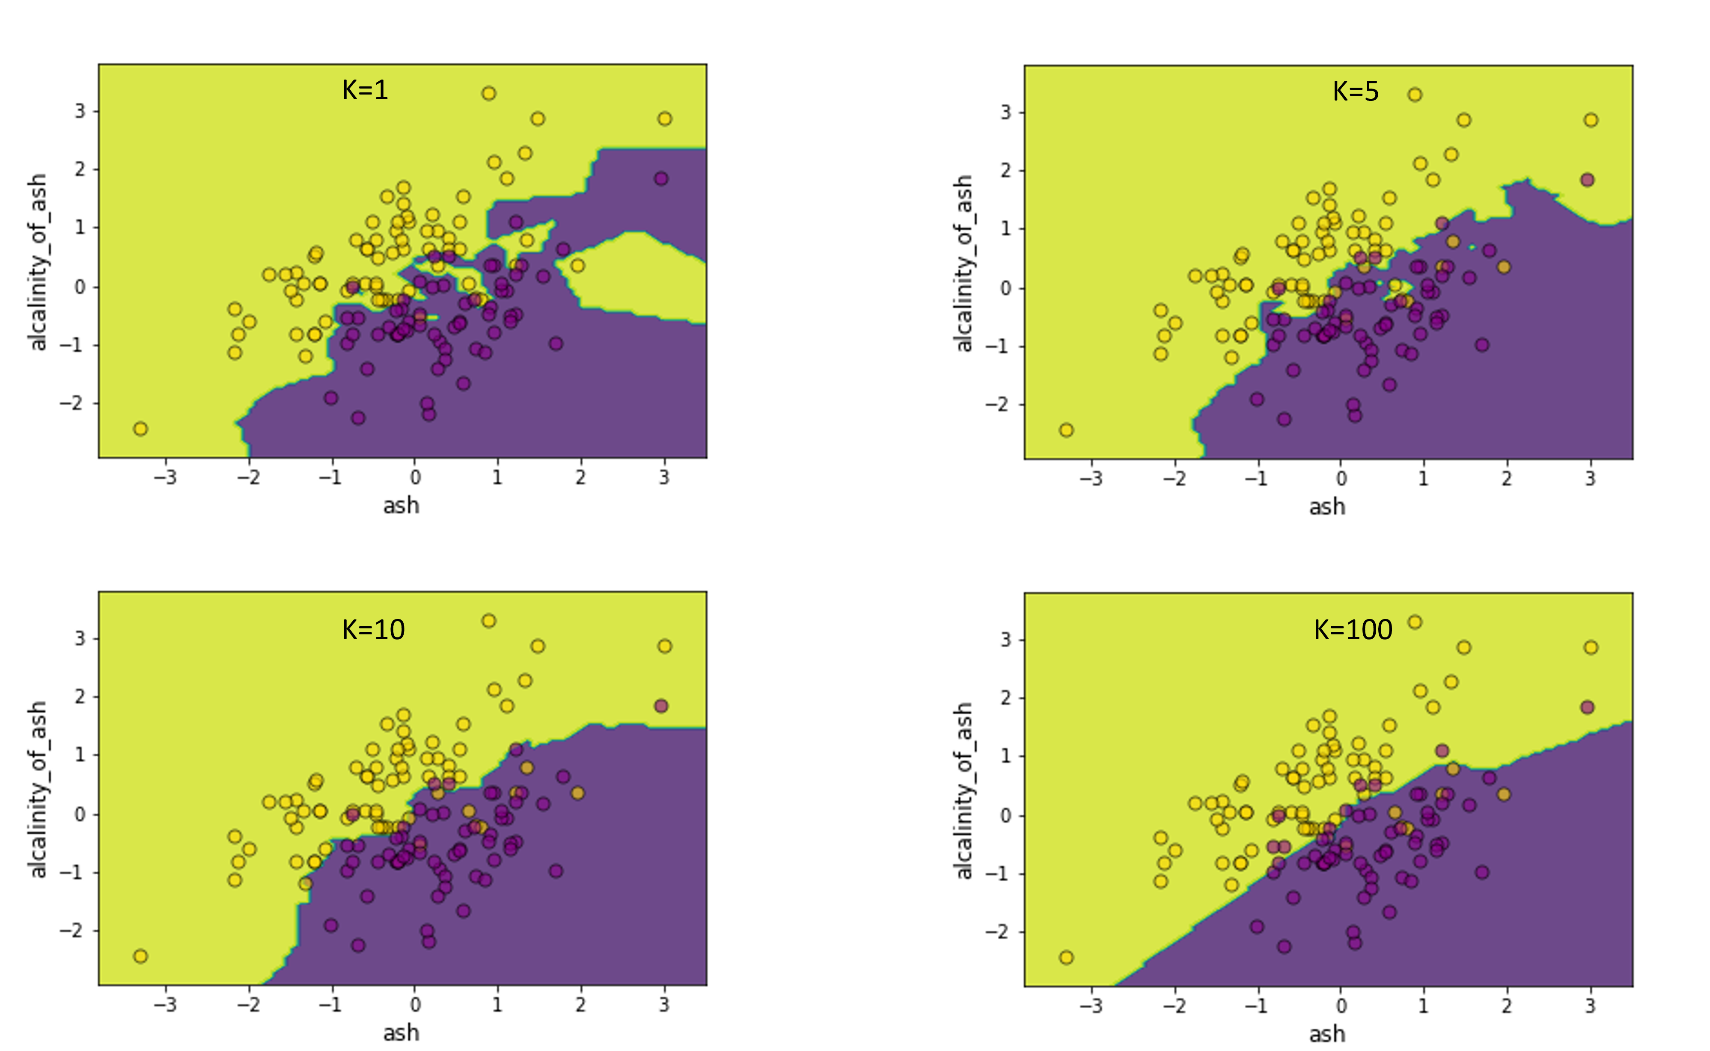
Choice of K
Choosing the right k is about finding a good balance between overfitting and underfitting.
Note: k is a hyperparameter
a hyperparameter is a setting in your model that you need to adjust (using cross-validation): model tuning, hyperparameter tuning
parameters are what define a model (building blocks). The goal of model training is to find the parameters while fixing its hyperparameters.

Slide 61
Choice of K
For very small values of k, the model can be sensitive to data noise, and thus can have high variance and can be prone to overfitting.
For very large values of k, the model considers far points as neighbors which will lead to a model with high errors, and thus high bias or underfitting.

Slide 62
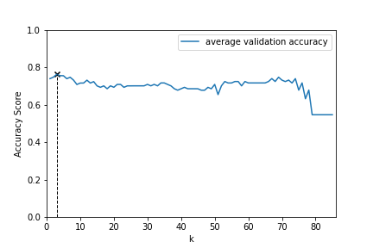
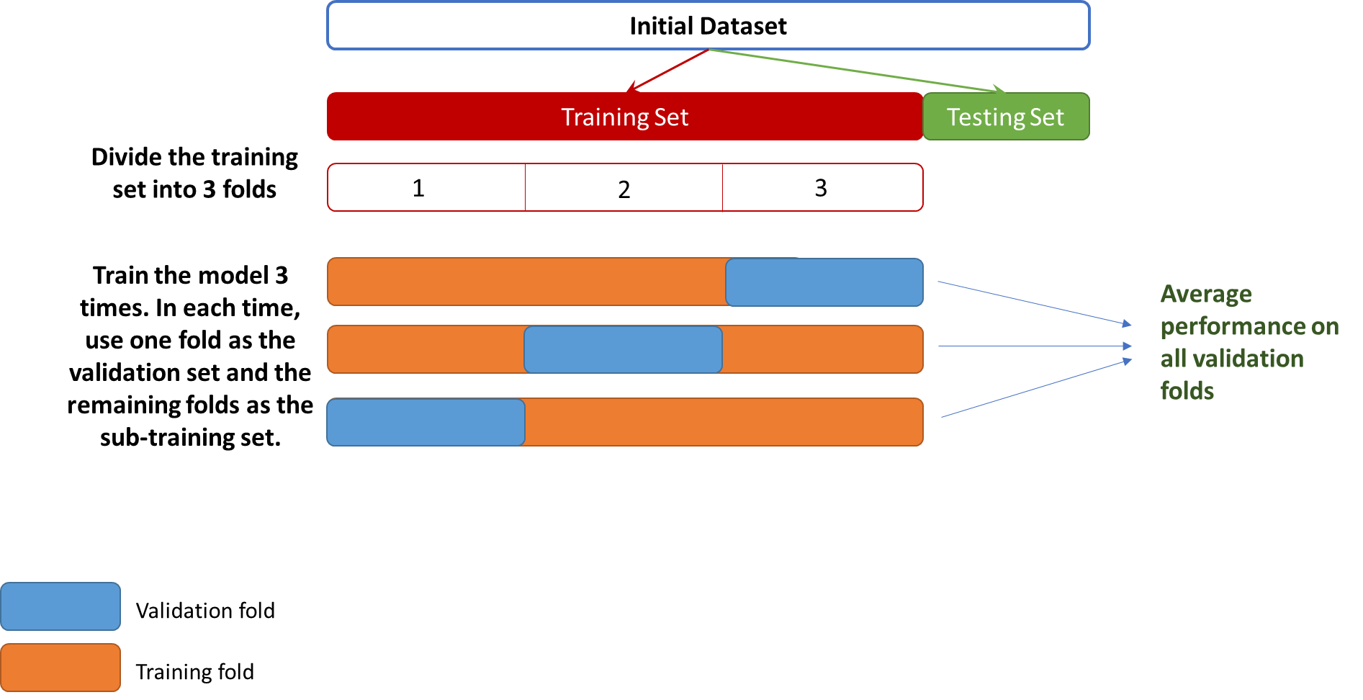
Choice of K : use k-fold cross validation
For each K, we compute the model’s response using cross validation.
The best average accuracy was obtained for k=3

Slide 63
Importance of Scaling

Slide 64
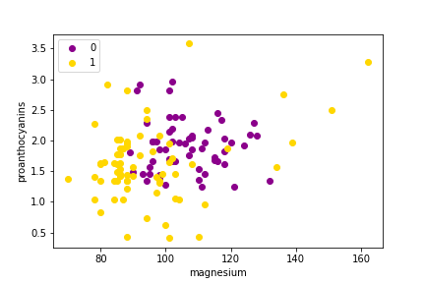
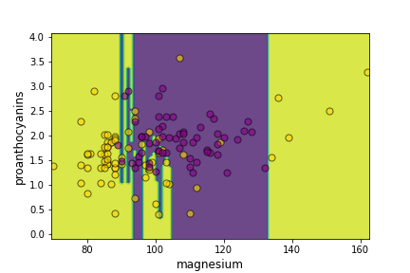
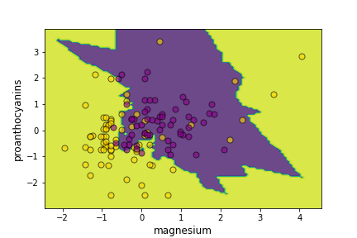
Feature Scaling
No Scaling
After Scaling

Slide 65
Feature Scaling
If one feature has much bigger range of values than others, this feature will end up contributing to the total distance more than the other features.
Euclidean distance squares the difference between the values of features, so that variations in the values of the features with greater range of values will be magnified more than those of other features.
This means that small variations in the feature with greater range of values will have more effect on the distance than the large variations in other features. The model will end up choosing the wrong neighbors.

Slide 66
KNN Advantages & Limitations

Slide 67
KNN Advantages
Simple model: The model has no training step and the prediction phase of the algorithm is easy to implement. The model requires few hyperparameters: choice of k and distance metric.
Non-linear model: The model does not assume any specific functional form, which results in more flexible decision boundaries (classification) or model’s response (regression) than those of linear models.
Adapts easily to new training samples: Since the training sample is the model itself, the model adjusts easily to new training samples. The new samples needs to be added to the old training samples and both stored in memory.
Extends easily to multi-class problem: The prediction algorithm of KNN works no matter how any classes to classify, it does not only work for binary classification. When predicting the label of a query point, we choose the majority vote label from its nearest neighbors.

Slide 68
KNN Disadvantages
Memory and computation costly: Since KNN is a lazy learning, the training data needs to be entirely stored, which might not be efficient from memory and storage perspective. Moreover, the prediction run time is slower than many other models.
Curse of dimensionality: In high-dimensional feature space, the data points become more sparse or scattered (especially if we don’t have lots of training samples), so that the nearest points to a given query point might be too far.
Sensitive to feature scaling: The performance of KNN is also affected if features have different scales, this is why it is important to make sure that features are scaled before applying KNN algorithm.
Interpretability: Linear models are considered interpretable model because the weights can give us insight into the contribution of each feature to the model. However, KNN is not able to do this. When computing the distance between two data points, all features are considered

